Slide 1
Hierarchal Clustering Technique
BY
ADNAN AMIN
IMSciences

Slide 2
Hierarchal Clustering
A method of cluster analysis which seeks to build a hierarchy of clusters.
groups similar objects into groups called clusters.
The endpoint is a set of clusters, where each cluster is distinct from each other cluster, and the objects within each cluster are broadly similar to each other.
Hierarchical clustering, also known as hierarchical cluster analysis.

Slide 3
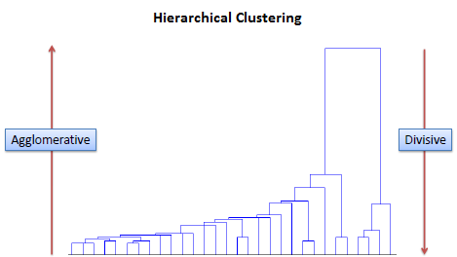
Types of Hierarchical Clustering
Divisive (Top-Down approach)
Agglomerative (Bottom-up approach)
Divisive (Top-Down approach)
We assign all the observations to a single cluster and then partition the cluster to two least similar clusters.
Finally, we proceed recursively on each cluster until there is one cluster for each observation.
Agglomerative (Bottom-up approach)
We assign each observation to its own cluster. Then, compute the similarity (e.g., distance) between each of the clusters and join the two most similar clusters.
Finally, repeat steps 2 and 3 until there is only a single cluster left.

Slide 4
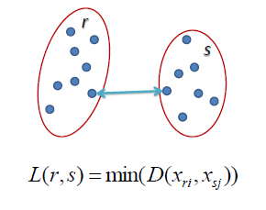
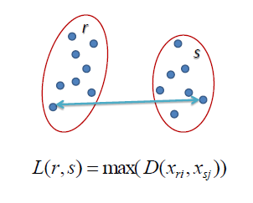
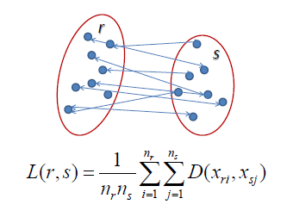
Methods to Measure Clusters
Single Linkage
In single linkage hierarchical clustering, the distance between two clusters is defined as the shortest distance between two points in each cluster.
For example, the distance between clusters “r” and “s” to the left is equal to the length of the arrow between their two closest points.
Complete Linkage
In complete linkage hierarchical clustering, the distance between two clusters is defined as the longest distance between two points in each cluster.
For example, the distance between clusters “r” and “s” to the left is equal to the length of the arrow between their two furthest points.
Average Linkage
In average linkage hierarchical clustering, the distance between two clusters is defined as the average distance between each point in one cluster to every point in the other cluster.
For example, the distance between clusters “r” and “s” to the left is equal to the average length each arrow between connecting the points of one cluster to the other.

Slide 5
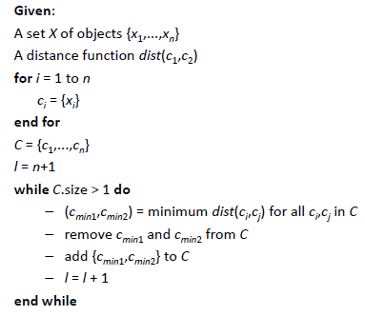
Agglomerative Algorithm

Slide 6
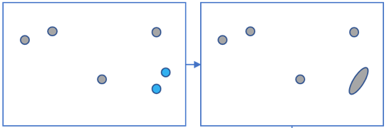
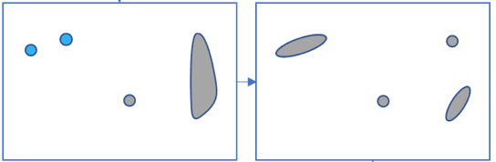

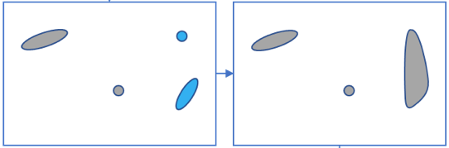
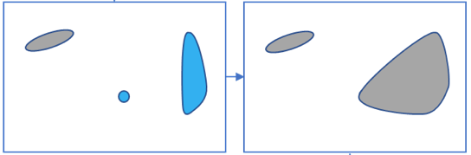
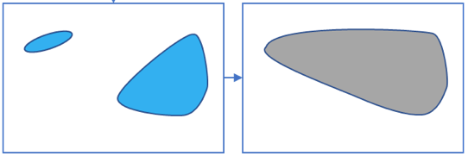
How hierarchical clustering works (Agglomerative Clustering):

Slide 7
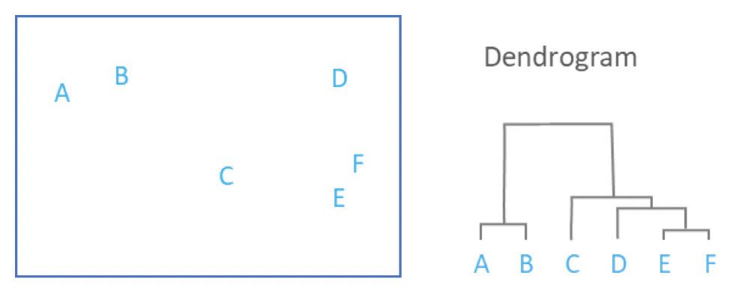
How hierarchical clustering works (Agglomerative Clustering):
The main output of Hierarchical Clustering is a dendrogram, which shows the hierarchical relationship between the clusters:

Slide 8
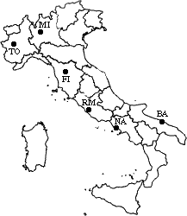
Dry-Run Example
Let’s now see a simple example: a hierarchical clustering of distances in kilometers between some Italian cities.
 | BA | FI | MI | NA | RM | TO
BA | 0 | 662 | 877 | 255 | 412 | 996
FI | 662 | 0 | 295 | 468 | 268 | 400
MI | 877 | 295 | 0 | 754 | 564 | 138
NA | 255 | 468 | 754 | 0 | 219 | 869
RM | 412 | 268 | 564 | 219 | 0 | 669
TO | 996 | 400 | 138 | 869 | 669 | 0

Slide 9
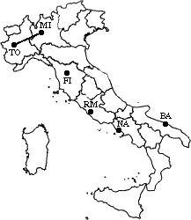
Agglomerative
The method used is single-linkage.
The distance between two clusters is defined as the shortest distance between two points in each cluster.
 | BA | FI | MI/TO | NA | RM
BA | 0 | 662 | 877 | 255 | 412
FI | 662 | 0 | 295 | 468 | 268
MI/TO | 877 | 295 | 0 | 754 | 564
NA | 255 | 468 | 754 | 0 | 219
RM | 412 | 268 | 564 | 219 | 0

Slide 10
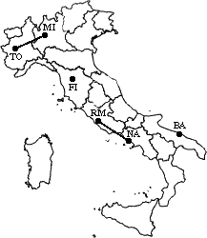
Dry-Run Example
 | BA | FI | MI/TO | NA/RM
BA | 0 | 662 | 877 | 255
FI | 662 | 0 | 295 | 268
MI/TO | 877 | 295 | 0 | 564
NA/RM | 255 | 268 | 564 | 0

Slide 11
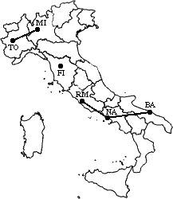
Dry-Run Example
 | BA/NA/RM | FI | MI/TO
BA/NA/RM | 0 | 268 | 564
FI | 268 | 0 | 295
MI/TO | 564 | 295 | 0

Slide 12
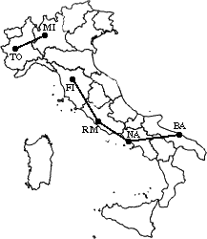
Dry-Run Example
 | BA/FI/NA/RM | MI/TO
BA/FI/NA/RM | 0 | 295
MI/TO | 295 | 0

Slide 13
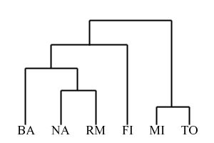
Dry-Run Example
The process is summarized by the following hierarchical tree:

Slide 14
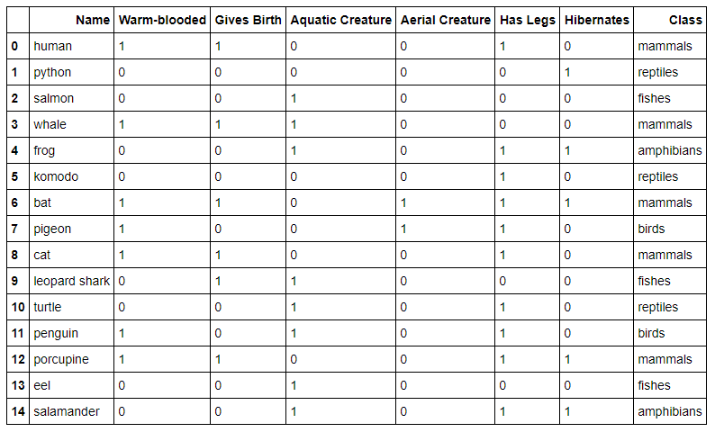
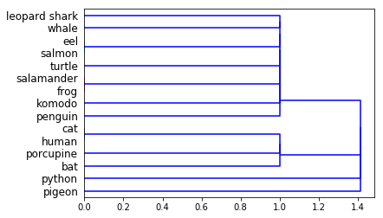
Problem and Implementation in Python
Import pandas as pd
from scipy.cluster import hierarchy
import matplotlib.pyplot as plt
%matplotlib inline
data = pd.read_csv('vertebrate.csv',header='infer’)
names = data['Name’]
Y = data['Class’]
X = data.drop(['Name','Class'],axis=1)
Z = hierarchy.linkage(X.as_matrix(), 'single’)
dn = hierarchy.dendrogram(Z,labels=names.tolist(),orientation='right')

Slide 15
Thank You!

